Slide 1
SDC Course Day 3
Suppressing magnitude tables

Slide 2
Recap

Slide 3
Magnitude table
age | gender | income | freq
young | female | 328 | 3
young | male | 105 | 1
middle | female | 417 | 2
middle | male | 395 | 3
old | female | 0 | 0
old | male | 3887 | 3
 | young | middle | old | Total
female | 328 | 417 | 0 | 745
male | 105 | 395 | 3887 | 4387
Total | 433 | 812 | 3887 | 5132
Each cell value represents the sum of a continuous variable
Each statistical unit has contributed a value
which can be zero

Slide 4
Disclosure in a Magnitude Table
age | gender | income | freq
young | female | 328 | 3
young | male | 105 | 1
middle | female | 417 | 2
middle | male | 395 | 3
old | female | 0 | 0
old | male | 3887 | 3
 | young | middle | old | Total
female | 328 | 417 | 0 | 745
male | 105 | 395 | 3887 | 4387
Total | 433 | 812 | 3887 | 5132
This value can be used to estimate …
We will prevent the disclosure of a statistical unit's value
especially if the value is considered sensitive
It should also not be possible to estimate the value with high accuracy
The value of a single unit is disclosed

Slide 5
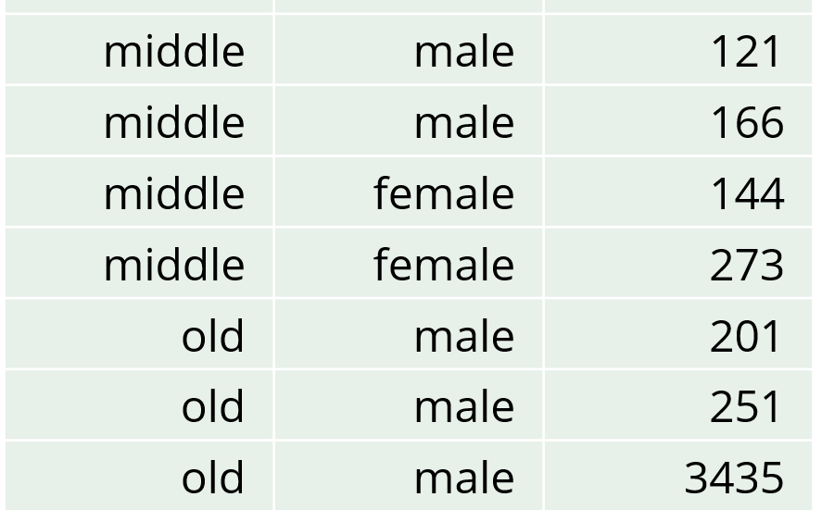
Estimate a value with high accuracy in a magnitude table
age | gender | income | freq
young | female | 328 | 3
young | male | 105 | 1
middle | female | 417 | 2
middle | male | 395 | 3
old | female | 0 | 0
old | male | 3887 | 3
 | young | middle | old | Total
female | 328 | 417 | 0 | 745
male | 105 | 395 | 3887 | 4387
Total | 433 | 812 | 3887 | 5132
This value can be used to estimate …
Suppose known that a person has a high income
The estimate, 3887, is only 13% higher than the person’s income
Acceptable?
The person with an income of 251 can subtract their own number
The estimate, 3887-251 = 3636, is only 5.8% higher than the person’s income
Acceptable?

Slide 6
Sensitive Cells in Magnitude Tables - These are cells that should be primary suppressed
 | young | middle | old | Total
female | 328 | 417 | 0 | 745
male | 105 | 395 | 3887 | 4387
Total | 433 | 812 | 3887 | 5132
Cells with few contributions
Other cells according to rules
(n,k) dominance rule: the top n contributors are more than k% of the cell total
p% rule: the second largest contributor can estimate the top contribution within p% of the real value.

Slide 7
Suppressing Magnitude Tables

Slide 8
Function interface
In theory: given prepared data, one function call that does it all: aggregate data to a table, primary suppress, secondary suppress
SuppressSmallCounts(
data = …,
freqVar = …,
dimVar = …,
formula = …,
hierarchies = …,
maxN = …,
protectZeros = …,
…)
SuppressFewContributors(
data = …,
numVar = …,
dimVar = …,
formula = …,
hierarchies = …,
contributorVar = …
maxN = …,
…)
SuppressDominantCells(
data = …,
numVar = …,
dimVar = …,
formula = …,
hierarchies = …,
contributorVar = …,
n = …,
k = …,
…)
How to suppress

Slide 9
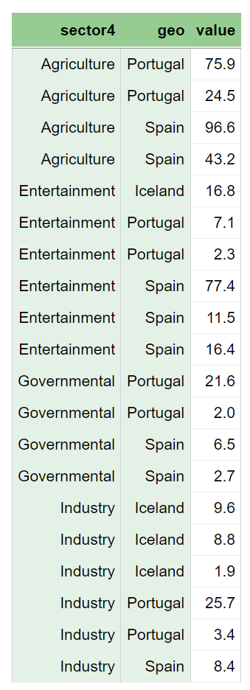
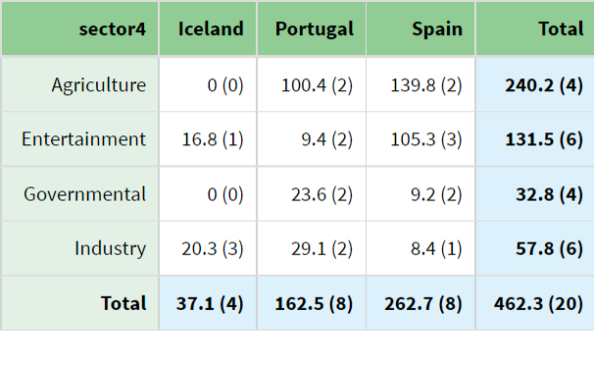
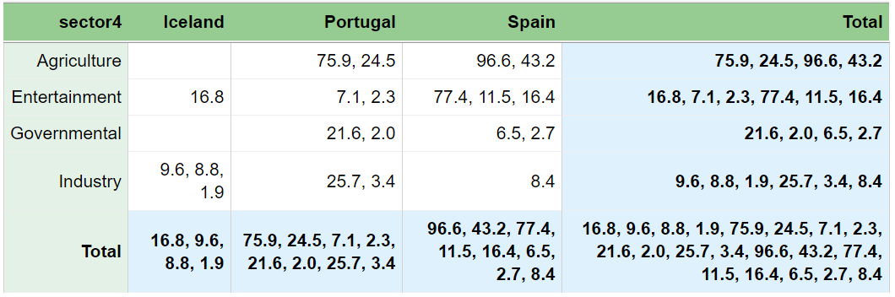
The output that GaussSuppression provides to users
How GaussSuppression works with the table internally

Slide 10
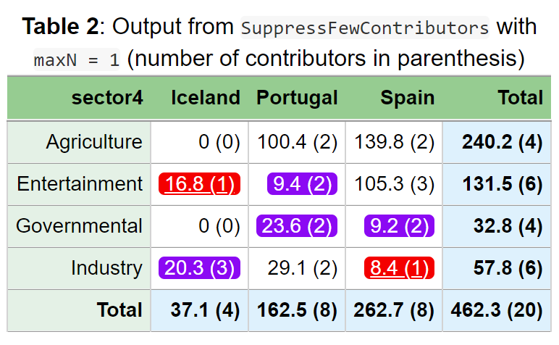
SuppressFewContributors
Primary suppression based on number of contributors
Suppress when number of contributors is less than or equal to threshold maxN
Checks each cell for number of contributors

Slide 11
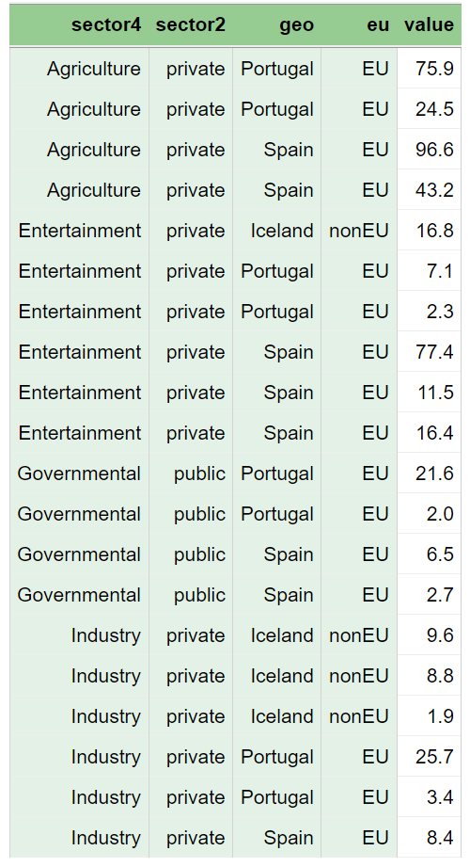
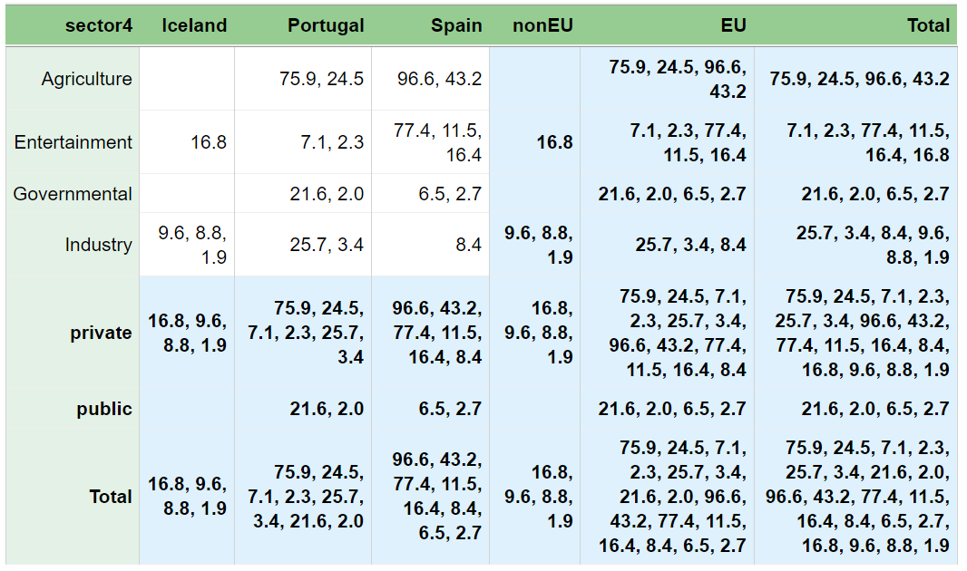
More complex, with automatic hierarchy detection:
dimVar = c("sector4", "sector2", "geo", "eu")

Slide 12
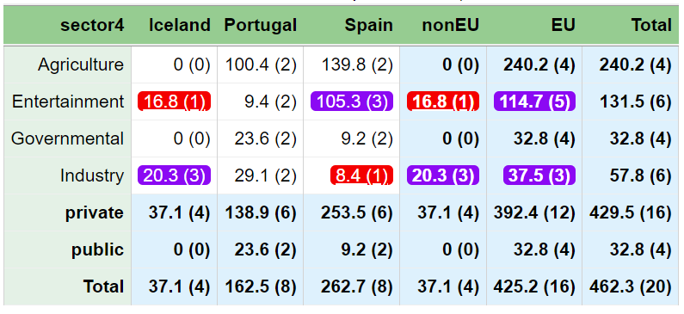
SuppressFewContributors(data = dataset,
numVar = "value",
dimVar = c("sector4", "sector2", "geo", "eu"),
maxN = 1)
All cells are checked, also marginals/totals!

Slide 13
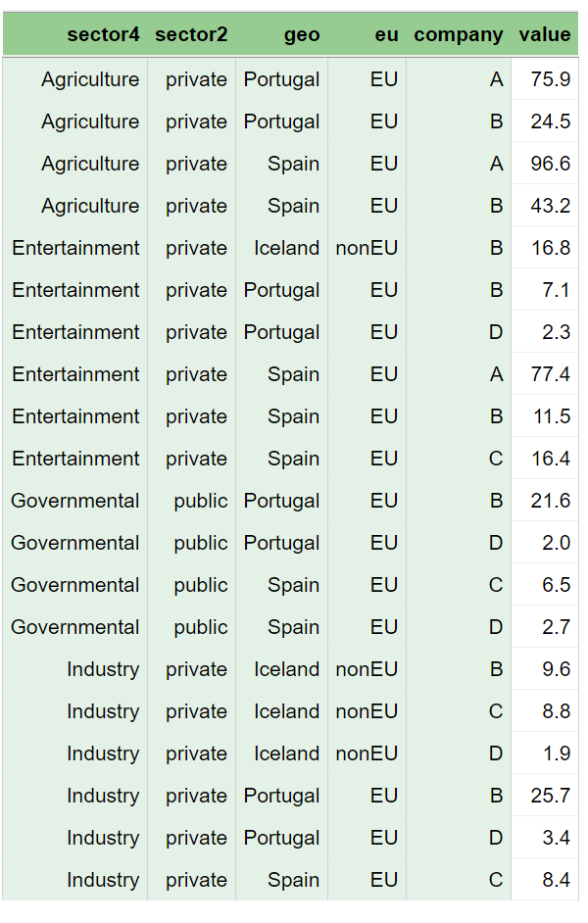
contributorVar = …
So far, we have counted contributors by counting rows of input data
But multiple rows might belong to the same statistical unit
A company can operate in multiple sectors/countries
A conglomerate can own multiple companies
We must take this into consideration: an attacker can have knowledge about a company/conglomerate

Slide 14
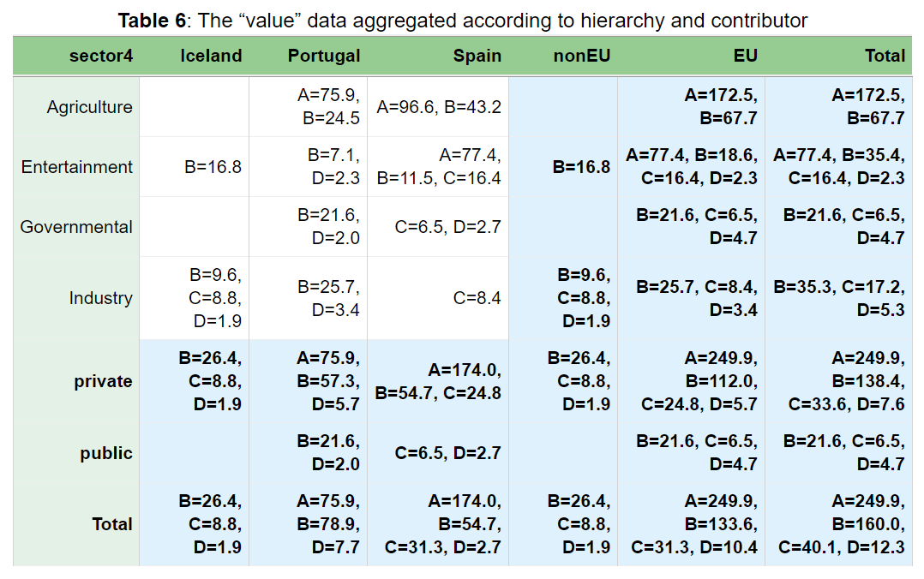
contributorVar

Slide 15
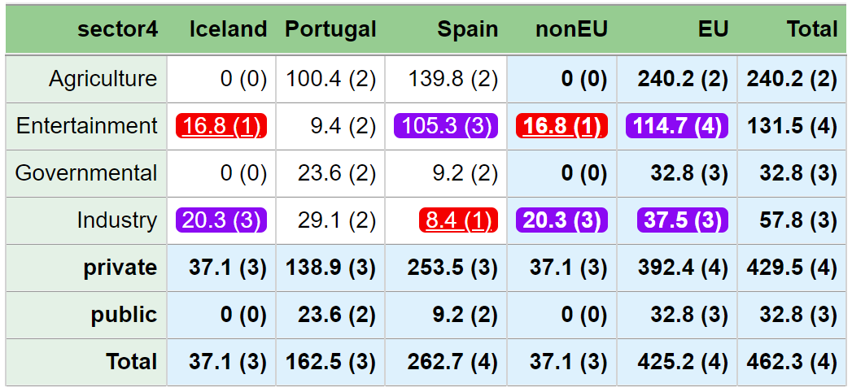
SuppressFewContributors(data = dataset,
numVar = "value",
dimVar = c("sector4", "sector2", "geo", "eu"),
maxN = 1,
contributorVar = "company")
Primary suppression based on number of contributors according to contributorVar
Suppress when number of contributors is less than or equal to threshold maxN
contributorVar

Slide 16
Dominance rule
SuppressDominantCells
n=1: dominance when the largest contributor is more than k% of the cell value
n=2: dominance when the two largest contributors are more than k% of the cell value
Primary suppress if a dominance rule applies
Multiple dominance rules can be combined
Combining n=1 and n=2 is common
n = 1:2 is the same as n = c(1, 2)
Combined with multiple k values. For example: k = c(80, 90)
If the same contributor contributes with multiple values, these must be summed up first. We do this with
contributorVar

Slide 17
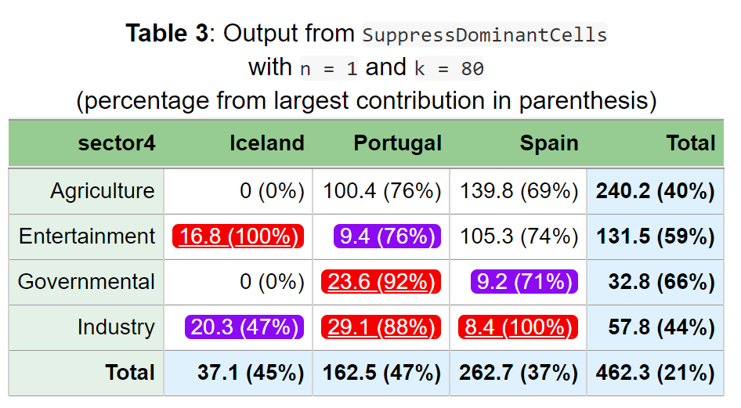
SuppressDominantCells(data = dataset,
numVar = "value",
dimVar = c("sector4", "sector2", "geo", "eu"),
n = 1, k = 80)
6.5/9.2 = 0.71
96.6/462.3 = 0.21
Often use multiple
dominance rules
also
contributorVar

Slide 18
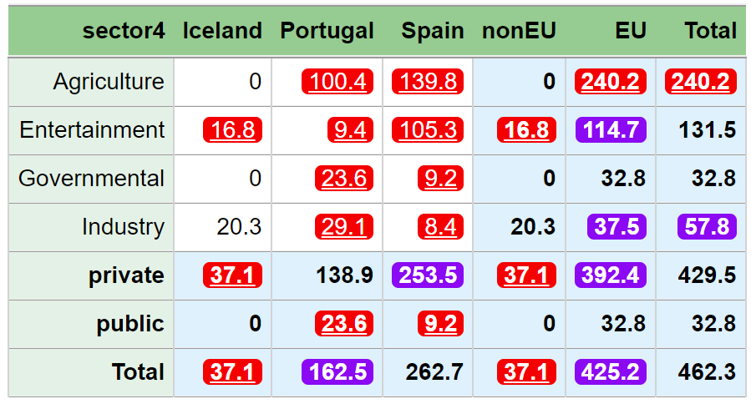
SuppressDominantCells(data = dataset,
numVar = "value",
dimVar = c("sector4", "sector2", "geo", "eu"),
n = 1:2, k = c(70, 99),
contributorVar = "company")
Here (2,99) applies:
(96.6+43.2)/139.8 = 100
Here (1,70) applies:
26.4/37.1 = 0.71
contributorVar

Slide 19
Summary
These are only examples! Must choose according to local laws/policies
SuppressDominantCells(data = …,
numVar = …,
dimVar = …,
formula = …,
hierarchies = …,
contributorVar = …,
n = …,
k = …,
…)
SuppressDominantCells
Usually n = 1:2 which is the same as n = c(1, 2)
Combined with multiple k values. For example: k = c(80, 90)
SuppressFewContributors
Must choose threshold maxN (>1)
In both cases
Choose (at least) one numVar
Usually need to specify contributorVar
What about p% rule?
SuppressFewContributors(data = …,
numVar = …,
dimVar = …,
formula = …,
hierarchies = …,
contributorVar = …,
maxN = …,
…)

Slide 20
Suppressing with p%-rule
SuppressDominantCells(data = …,
numVar = …,
dimVar = …,
formula = …,
hierarchies = …,
contributorVar = …,
pPercent = …,
…)
GaussSuppression does not have own p% function
Might come in future versions
But can use SuppressDominantCells with a new parameter instead of n and k:
pPercent
Otherwise the same as SuppressDominantCells

Slide 21
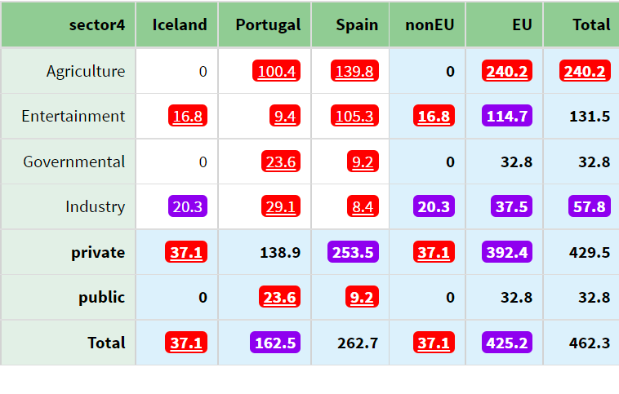
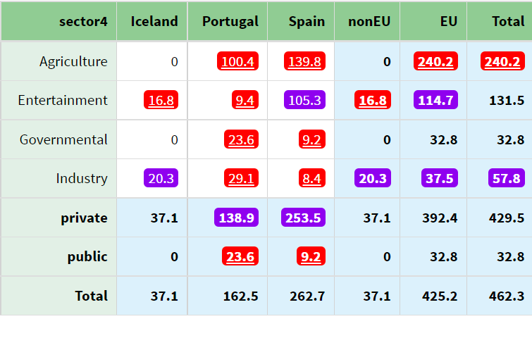
Suppression using dominance rules
Suppression using p% rule
SuppressDominantCells(data = dataset,
numVar = "value",
dimVar = c("sector4", "sector2", "geo", "eu"),
n = 1:2, k = c(70, 99),
contributorVar = "company")
SuppressDominantCells(data = dataset,
numVar = "value",
dimVar = c("sector4", "sector2", "geo", "eu"),
pPercent = 5,
contributorVar = "company")

Slide 22
Exercises
R/magnitude_suppression.R

